Slide 1
Alma Check Availability and Pricing with OASIS.
Yoel Kortick
Senior Librarian

Slide 2
Introduction
Vendor Configuration
The Alma Menu Entry
Searching OASIS from within Alma
Creating the order

Slide 3
Introduction
The integration described here allows the Alma staff user to
  Search ProQuest OASIS from within Alma
  Find a record in ProQuest OASIS and know it’s price and availability
  Via one click create the order in Alma and in OASIS

Slide 4
Introduction
This
  Provides a streamlined and efficient method of ordering for Alma institutions working with OASIS
  Complements the already existing integration whereby a user can search from inside OASIS, create an order in OASIS, have the order also automatically get created in Alma.

Slide 5
Introduction
Therefore an Alma library can now experience full integration with OASIS whether they start their search and ordering process from within OASIS or from within Alma.

Slide 6
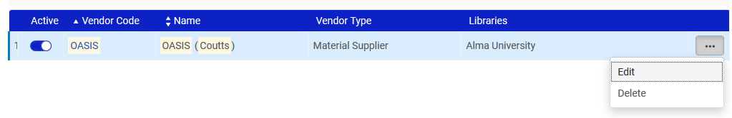
Vendor Configuration
We will edit vendor ProQuest. Editing and viewing the vendor is not necessary every time the user logs into Alma. It is a one-time configuration. We are showing here the configuration.
The vendor can have any name and code.

Slide 7
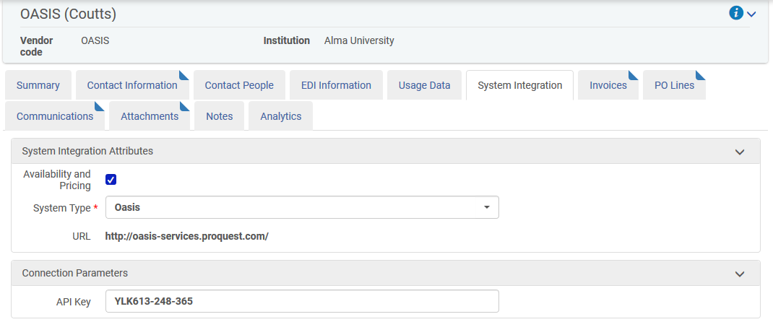
Vendor Configuration
In the "System Integration tab" for vendor OASOS (Coutts) we have defined to have "Check Availability and Pricing" with OASIS and we have entered our API key received from OASIS

Slide 8
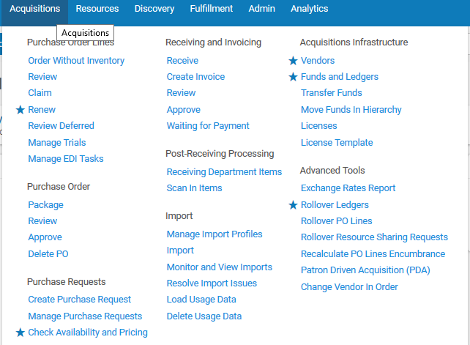
The Alma Menu Entry
The Alma Acquisitions menu includes a link to "Check Availability and Pricing" because the staff user has relevant permissions.
The user has "starred" the menu entry for the "quick links".

Slide 9
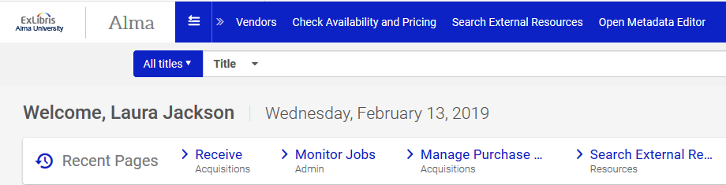
The Alma Menu Entry
User Laura Jackson can choose the "Check Availability and Pricing" from the "Quick Links" because she defined it from the main menu.

Slide 10
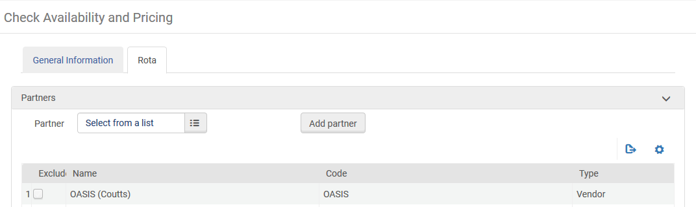
Searching OASIS from within Alma
The "Check Availability and Pricing" screen opens.
Because "System Integration" was defined for vendor "ProQuest" it automatically appears in the Rota tab of the "Check Availability and Pricing"

Slide 11
Searching OASIS from within Alma
In the "General Information" tab it is possible to
Search OASIS for one specific record, for example via ISBN.
Search OASIS for multiple records, for example via Word from Title
In the next slide we will search for one specific record: ISBN 1680782851 which is title "Information literacy in the digital age"

Slide 12
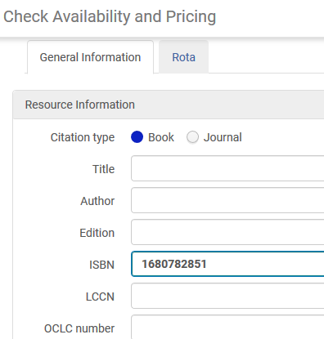
Searching OASIS from within Alma

Slide 13
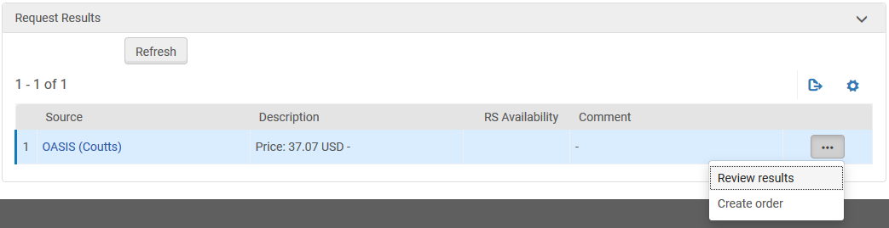
Searching OASIS from within Alma
The result appears in the bottom of the screen with the price.
The user can
Review the results to see more details of the record
Directly create the order

Slide 14
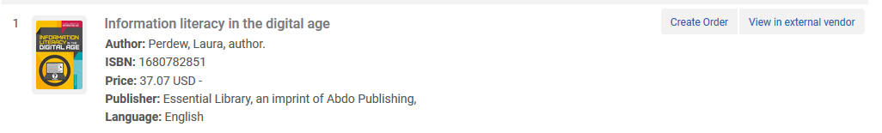
Searching OASIS from within Alma
Here we have chosen "Review Results".
From here we can view the record in the external vendor (OASIS) or create the order.
We will choose "View in external vendor"

Slide 15
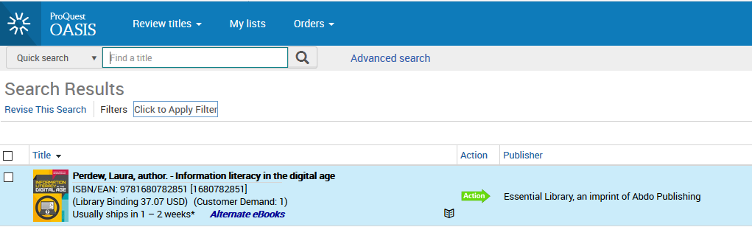
Searching OASIS from within Alma
"View in external vendor" brings us to https://oasis.proquest.com/searchresults with the record we found while in Alma

Slide 16
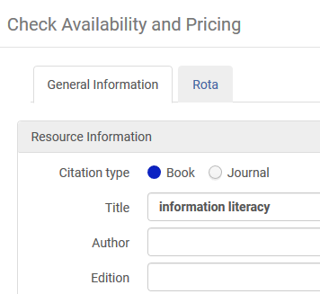
Searching OASIS from within Alma
Now we will search OASIS from within Alma for multiple records using "Word from title"

Slide 17
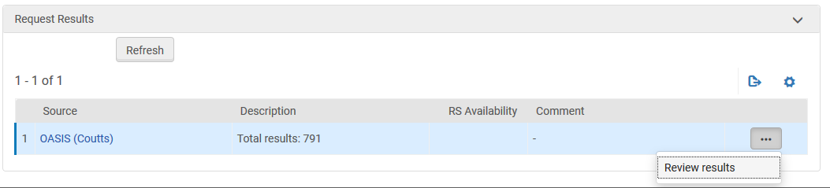
Searching OASIS from within Alma
From the results we will choose "Review results"

Slide 18
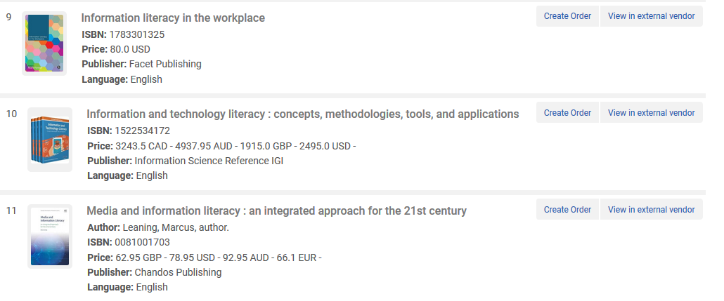
Creating the order
From each of the results we can "View in External Vendor" or "Create Order"

Slide 19
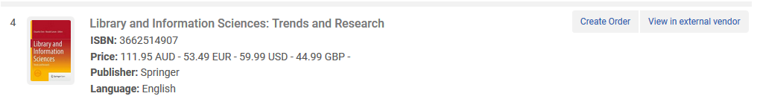
Creating the order
We will now click "Create Order" for ISBN 3662514907 “Library and Information Sciences: Trends and Research". It costs 59.99 USD.

Slide 20
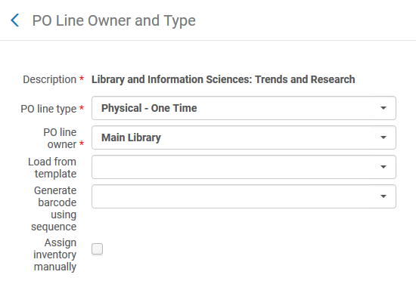
Creating the order
The POL type and library is chosen just like any other order created in Alma

Slide 21
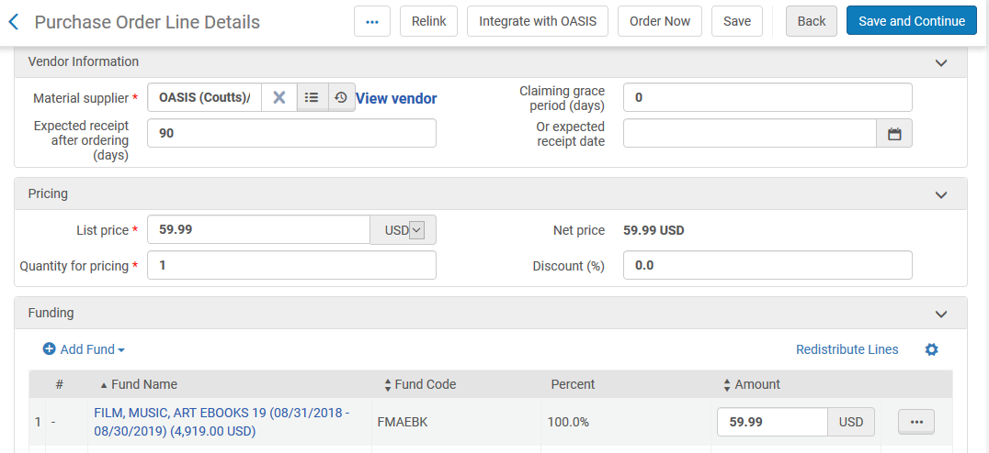
Creating the order
The price and vendor is automatically filled in (but can be changed manually)

Slide 22
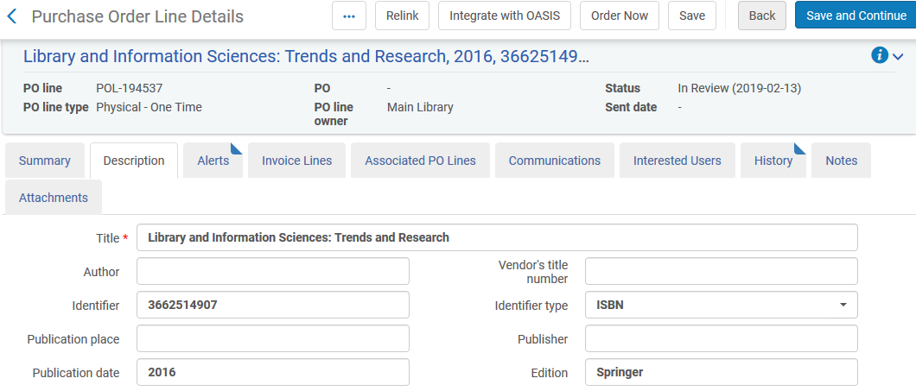
Creating the order
The POL description tab contains the bibliographic information from OASIS

Slide 23
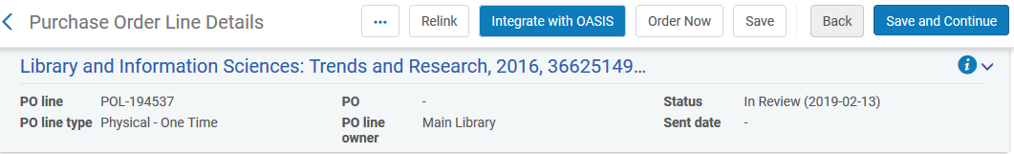
Creating the order
Clicking "Integrate with OASIS" will create the order in Alma and in OASIS

Slide 24
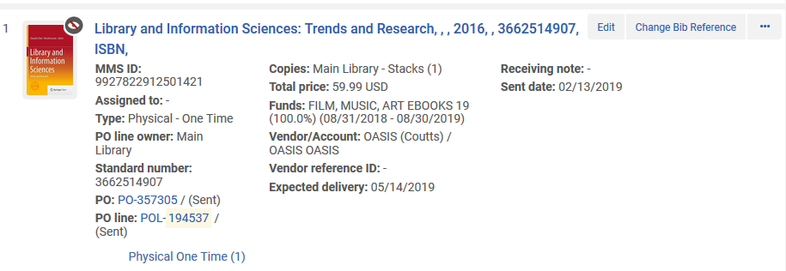
Creating the order
The order is created in Alma as POL-194537 and the acquisition method is "Purchase at vendor system".
The bibliographic record is by default suppressed because the assumption is that the library will not want to publish to discovery until the item arrives.

Slide 25
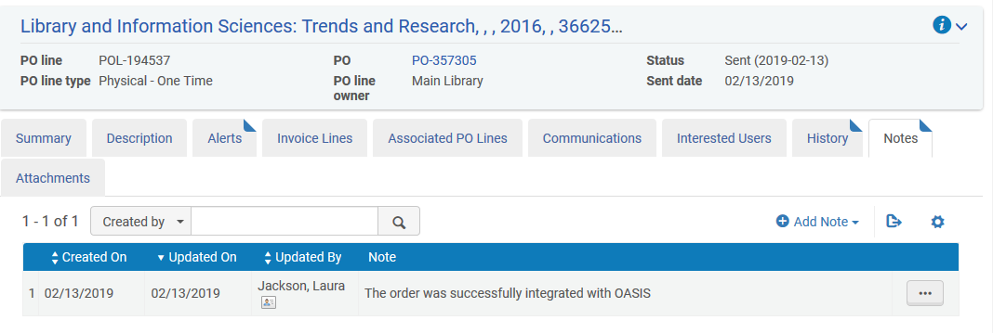
Creating the order
The "notes" tab of the POL in Alma states that it was successfully integrated with OASIS

Slide 26
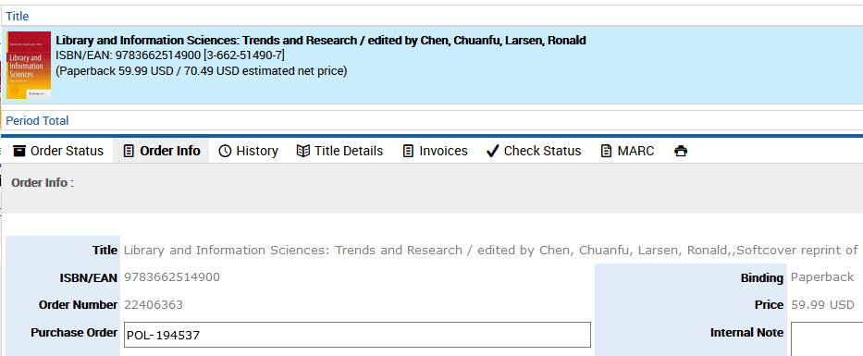
Creating the order
The order also got created in OASIS. Because there is a full integration here the Alma order number POL-194537 got copied to the order in OASIS

